Slide 1
SAFETY ALERT-CALL TO ACTION ( CTA) : Lock Out /Tag Out
INCIDENT INFORMATION TWO fatalities occurred when employees entered enclosures with energized equipment. First, a contract employee entered a palletizer enclosure for routine cleaning without applying Lock Out/Tag Out (LOTO) to isolate hazardous energies. The worker climbed under a machine guard to access and clean an adjacent palletizer. The worker incurred fatal injuries when triggering an infrared pallet detector which cycled the machine. In a second incident at a different location, a palletizer was jammed with a pallet of product. Three contract workers entered the enclosure to clear the jam without applying LOTO. They relied on interlocks which did not disable the palletizer. When the pallet was freed, the machine cycled quickly and caught a worker who later died from their injuries.
CALL TO ACTION
1. REVIEW and COMPLY with KORE ES‐RQ‐160: Hazardous Energy Control.
2. APPLY Lock Out / Tag Out to isolate hazardous energies prior to working on or around energized equipment.
3. RETRY equipment after applying LOTO to ensure energies have been isolated.
4. DO NOT RELY on e‐Stops, light curtains, and/or safety interlocks as substitutes for LOTO.
5. DO NOT OVERRIDE OR DISABLE safety devices, interlocks, machine guarding, and/or other equipment installed to protect people from energized machinery.
6. WRITE equipment‐specific Lock out / Tag out procedures for all machines, as per KORE.
7. TRAIN workers, including contractors, who will clean, maintain, and operate energized equipment on each machine’s LOTO procedure.
8. RETRAIN workers when changes are made to LOTO procedures, equipment, process, OR when evidence suggests deficiencies in a worker’s ability to perform effective LOTO.
9. LOOK OUT for the safety of fellow employees.
10. PREVENT incidents at every opportunity.
SAFETY OPPORTUNITIES
✓ Automated, enclosed operations, such as palletizers and wrappers, pose the additional risk of remote start up.
✓ Consider electrical, mechanical, hydraulic, pneumatic, chemical, thermal & gravity as energy sources for LOTO.
✓ Are your employees and contractors adequately trained to safely complete their work?

Slide 2
SAFETY ALERT-CALL TO ACTION ( CTA) : Confined Space (Water Storage Tank)
A shift chemist went on soft water tank in water treatment plant without informing to anyone. For inspection he opened the manhole of soft water storage tank and accidently fell into the tank and later died due to asphyxia.
CALL TO ACTION
1.Restricted Access: All the confined spaces always be under restricted access through locks, seals,bolts and / or administrative controls). Keys of locks shall be with the authorized person.
2. Supervision: Confined space shall be opened under the supervision of second person (attendant).
3. Training: Only trained and authorized workers shall work in confined space. Training shall ensure awareness of these workers on all potential hazards during access to or entry inside all confined spaces.
4. Barricading: Refer the example of barricading in below picture to avoid accidental fall in water storage tanks.
5.Camera: Install cameras at critical locations to see activities of employee and to take immediate action if required.
6. REVIEW & APPLY KORE ES-RQ-105: Confined Space Entry.
7. LOOK OUT for the safety of fellow employees.
8. PREVENT incidents
SAFETY OPPORTUNITIES
✓ In our plants, we have various confined space in different areas and this need entry on defined frequency e.g. inspections, cleaning, carbon change etc. to ensure our process work effectively and efficiently.
✓ Remember: In confined spaces risk of asphyxia is very high due in our system due to water, chemical storage etc.
✓ Confined Space is a critical QSE Audit Focus Area and will be assessed in every GAO audit to ensure all the requirements mentioned under ES-RQ-105 are effectively implemented.

Slide 3
SAFETY ALERT-CALL TO ACTION ( CTA) : Electrical Safety
INCIDENT INFORMATION A third party contractor was cleaning / sanitizing a filling line. The pressurized washing equipment in use had a spliced extension cord and was plugged into a standard electrical outlet. The contractor was discovered face down and had died from cardiac arrest, suspected to be from electrocution.
CALL TO ACTION
1. SELF-INSPECT power tools, electrical cords and outlets before use for visible wear, attempted repairs or exposed insulation.
2. USE Ground Fault Circuit Interrupters (GFCIs) or Residual Current Devices (RCDs). They shut off electrical power in the event of a ground fault…and save lives.
3. REPLACE visibly worn equipment and cords to minimize risk of electrical shock. An authorized electrician may repair.
4. *ENSURE fixtures, switches, circuit breakers and switchboards installed in wet locations are fit for purpose.
5. *INSTALL GFCIs and RCDs as prescribed in KORE.
6. SEPARATE electricity from water at all times.
7. REVIEW & APPLY KORE ES-RQ-120: Electrical Safety Guidelines.
8. LOOK OUT for the safety of fellow employees.
9. PREVENT incidents.
SAFETY OPPORTUNITIES
✓ Much of our business involves cleaning with water to ensure high quality of our products.
✓ Our lives depend on taking a moment to consider the hazards of tasks we are about to complete.
✓ Remember: Electricity + Water React Violently and can result in electrocution.
✓ Electrical Safety is a critical QSE Audit Focus Area, a Top 10 Fatality Program and will be assessed in every GAO audit, including provision of GFCIs / RCDs and Arc Flash controls.
✓ *In wet locations, use portable GFCIs or RCDs if the electrical source is not equipped with a GFCI or RCD. To ensure proper protection, plug the portable GFCI or RCD into the power source, then plug the extension cord into the GFCI or RCD.

Slide 4
SAFETY ALERT-CALL TO ACTION ( CTA) : RO Membrane Removal
INCIDENT INFORMATION 3‐4 people were removing RO Membranes for cleaning from a RO System. While removing elements, a membrane released rapidly due to high water pressure. Due to the force, two of an operator’s fingers got caught between the membrane they were holding and the adjacent wall. A right finger was amputated, and a left finger was severely cut.
CALL TO ACTION
1. REVIEW the removal protocol with emphasis on personnel safety and process control.
2. FOLLOW the equipment supplier’s recommendations for safe membrane removal.
3. VERIFY that pressure vessels have been depressurized / dewatered prior to removal.
4. CONTROL hazardous energy by locking out / tagging out.
5. ENSURE adequate personnel for safe removal: at least one person on the pushing end to constantly monitor the force being used who is not the same person on the element receiving end.
6. WEAR required safety equipment such as; safety shoes, safety glasses and gloves.
7. CONSIDER and PLAN for potential work at height exposures sometimes encountered during this cleaning activity.
8. PREVENT incidents at every opportunity.
SAFETY OPPORTUNITIES
✓ This maintenance activity constitutes a routine operation. Always perform a risk assessment to evaluate the potential for injury.
✓ Remember: Manual force should be adequate for removing elements from pressure vessels. Should additional force be required repeatedly, the overall process should be evaluated to determine if the pretreatment systems are sufficient to protect our employees and the equipment.
✓ Using water pressure to remove RO Membranes is a risky practice that must be stopped immediately.
✓ Dedicate 1.5 meters on either end of a unit when possible to be able to push the elements out.
✓ The elements are heavy and slippery, and some components of the equipment have pinch points and sharp edges requiring personal protective equipment.

Slide 5
SAFETY ALERT-CALL TO ACTION ( CTA) : Compressed Gas
INCIDENT INFORMATION Styrene gas had leaked out from two tanks (5,000 T) due to chemical reaction in a Chemical Plant on 07 May 2020. This was due to heat production inside the tanks, that was left undetected since March 2020 as a result of COVID-19 shutdown. As per current reports, this incident has so far caused death of 11 people and has left several people sick.
CALL TO ACTION
1. Exercise due diligence in terms of compliance to KORE (ES-RQ-100) and regulatory requirements on design, operation, inspection and maintenance of compressed gas systems. Check if inspection or maintenance of any of these systems (as due during the COVID-19 shutdown period) were missed. 2. Proactively review safety risk assessment of all the compressed gas management systems.
3. Revisit the risk assessments at periodic intervals while utilizing learnings from incidents in Coca-Cola Operations as well as other companies and also when resuming operations post long periods of shutdown as in the current scenario due to COVID-19. Evaluate the adequacy of existing controls and determine any additional control measures needed for mitigating the identified safety risks specific to each situation.
4. Train the concerned associates, operators and contracted workforce. Only the trained & competent personnel must be authorized to operate and maintain the compressed gas management systems.
5. Any maintenance work on compressed gas management systems must be carried out only post issuance of authorized Work permits and pre-work risk assessment (such as ensuring required tools / accessories must be in proper working condition).
6. Maintain necessary access control and clearance around the compressed gas storage areas.
7. Implement all the controls as specified in applicable regulations, KORE Module (ES-RQ-100) and risk assessments for managing compressed gas systems. For e.g.
a. Regular inspection of the compressed gas systems as per OEM guidelines and / or applicable KORE requirements. For e.g. Functioning of all the safety valves & pressure gauges, safety
interlocks, audio & visual safety alarm systems, condition monitoring of transfer lines for any rust, corrosion, pitting, damage, puncture, pin holes, etc.
b. Timely calibration done of all online monitoring meters (e.g. ambient ozone, ammonia,oxygen meter, etc.), pressure gauges, etc.
c. Comply with frequency of periodic testing of pressure vessels, safety valves, etc. as per applicable regulations and KORE requirements.
8. Ensure that specified PPEs are available with the associates for use during routine operation of the compressed gas systems.
9. Follow KORE requirements (ES-RQ-205) on cleaning, inspection, maintenance and storage of PPEs to ensure that they are always in good condition for use. E.g. Respiratory Masks, Full-Face Shield, Loose Fitting Cryogenic Handling Gloves, Apron and Cuff less pants, etc.
10. Ensure rescue equipment’s are in proper operating condition and meet OEM & KORE requirements (as applicable). For e.g. Self-Contained Breathing Apparatus (SCBA) air supply must be of required quality and in sufficient quantity. Personnel required to operate SCBA must be trained and should have taken fit test as per KORE Requirement (ES-RQ-210).

Slide 6
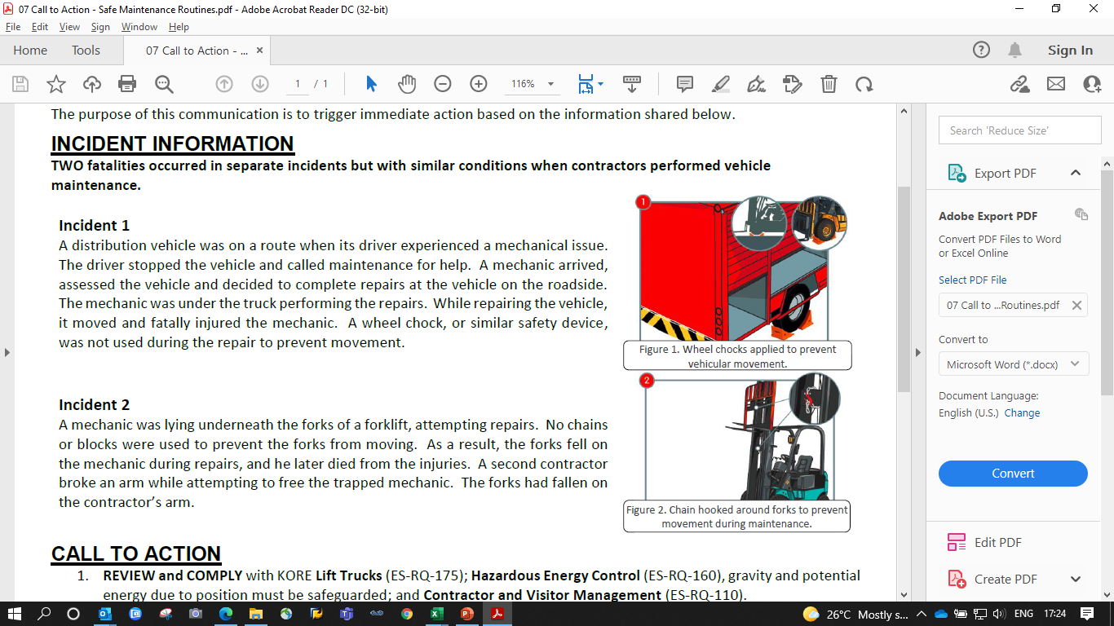
SAFETY ALERT-CALL TO ACTION ( CTA) : Safe Maintenance Activities (Forklift)
Incident 1 A distribution vehicle was on a route when its driver experienced a mechanical issue. The driver stopped the vehicle and called maintenance for help. A mechanic arrived, assessed the vehicle and decided to complete repairs at the vehicle on the roadside. The mechanic was under the truck performing the repairs. While repairing the vehicle, it moved and fatally injured the mechanic. A wheel chock, or similar safety device, was not used during the repair to prevent movement.
Incident 2
A mechanic was lying underneath the forks of a forklift, attempting repairs. No chains or blocks were used to prevent the forks from moving. As a result, the forks fell on the mechanic during repairs, and he later died from the injuries. A second contractor broke an arm while attempting to free the trapped mechanic. The forks had fallen on the contractor’s arm.
CALL TO ACTION
1. REVIEW and COMPLY with KORE Lift Trucks (ES‐RQ‐175); Hazardous Energy Control (ES-RQ-160), gravity and potential energy due to position must be safeguarded; and Contractor and Visitor Management (ES-RQ-110).
2. PRE-PLAN to discuss a safe way to perform tasks and implement safety measures before performing work.
3. APPLY a safe-blocking system prior to working on or around vehicles, forks and equipment.
4. DO NOT TAKE SHORTCUTS when performing work. Never bypass safety devices, interlocks, machine guarding, and/or other installed equipment. These precautions will protect people from movement of machinery.
5. REMEMBER that potential energy due to gravity or positioning is a hazardous energy identified under KORE ES-RQ-160. Include this hazardous energy when developing specific lockout/tagout (LOTO) procedures for maintenance areas.
6. TRAIN AND MONITOR all workers, including contractors, who will clean, maintain and repair vehicles or equipment.
7. LOOK OUT for the safety of fellow employees.
8. PREVENT incidents at every opportunity.
SAFETY MUST DOs
✓ Use a wheel chock, chain or other device(s) to prevent movement of equipment while servicing or performing maintenance. Apply LOTO to isolate potential energy due to position.
✓ Similarly, use chains, a support wedge or other device(s) to secure forks when performing forklift maintenance.
✓ Monitor contractors to ensure that they comply with the same safety requirements as company employees.

Slide 7
SAFETY ALERT-CALL TO ACTION ( CTA) : Fall from Height (Roof) Incident
INCIDENT INFORMATION A contractor workman along with three of his colleagues were at site for scaffolding erection work. Contractor Supervisor and Project Management Consultant were in the process of issuing work permit. Before the permit got approved by the safety personnel, they climbed to the roof for retrieving scaffolding material and one of the contract men fell from approx. 30ft (9.1 meters) height through the fragile sky light roof sheet.
CALL TO ACTION
1. ACCOUNTABILITY from the Management team is key to change the mindset on SAFETY CULTURE and keep the purpose that, ‘everyone safe should be greater than only delivering results’. We can’t delegate responsibility to external, we must be all the time accountable for safety condition and behaviours even for our visitors and contractors or sub-contractors.
➢ Be sure to clearly define roles and responsibilities to ensure safety in the workplace.
2. ELIMINATE, through risk assessment, any potential causes for harm. Evaluate any risk conditions related to the activity that could generate additional hazards.
➢ Consider also those dangerous works required outside the facility plant, as in distribution centers, warehouses, and any other offsite relatively far-lying areas.
3. ESTABLISH a process to ensure that contract workers have the necessary qualifications, capabilities, competency, and authorization to perform the expected dangerous work.
4. ENSURE that each contractor or sub-contractor that enters the facility premises have the proper permissions to access dangerous areas and must comply with all safety guidelines prior to assigning any work.
➢ Set clear safety expectations before work begins, even for visitors, contractors and sub-contractors.
5. CONDUCT a pre-risk assessment in partnership with all involved parties (plant personnel, contractor personnel, etc), prior to each “dangerous activity and task” to identify the hazards and controls that will be utilized during work.
➢ “Dangerous activities and tasks” include at minimum (and are not limited to) the following:
• Work at Height • Confined Space Entry • Electrical Work • Line-Breaking Work • Hazardous Energy Work • Excavation and Civil Work • Critical Lifting Work • Compressed gas management
• Core Drilling, surface penetration and excavation • Any other work identified by a general risk assessment
6. VERIFY that contractors are working safely.
➢ Implement a proactive monitoring program to ensure that a bottler representative is making regular observations of the contractors & sub-contractors and providing feedback.
➢ Make sure everyone at the site are aware of the work, knows their responsibility to observe the safety of the contractors, and to report any unsafe work.
7. ENSURE that the appropriate facility workforce is trained on any dangerous work.
➢ Be sure that all persons involved have a proper understanding and knowledge of all elements of the activities/tasks described within the pre-risk assessment.
➢ Before any work begins, plant staff must authorize every work permit for dangerous activities and tasks.
➢ Ensure that all mitigation controls are in place and the conditions of the PPE, hand tools, and power tools are good and safe.
8. PREVENT incidents at every opportunity, being able to stop any activity that evidence unsafe conditions or behaviors.

Slide 8
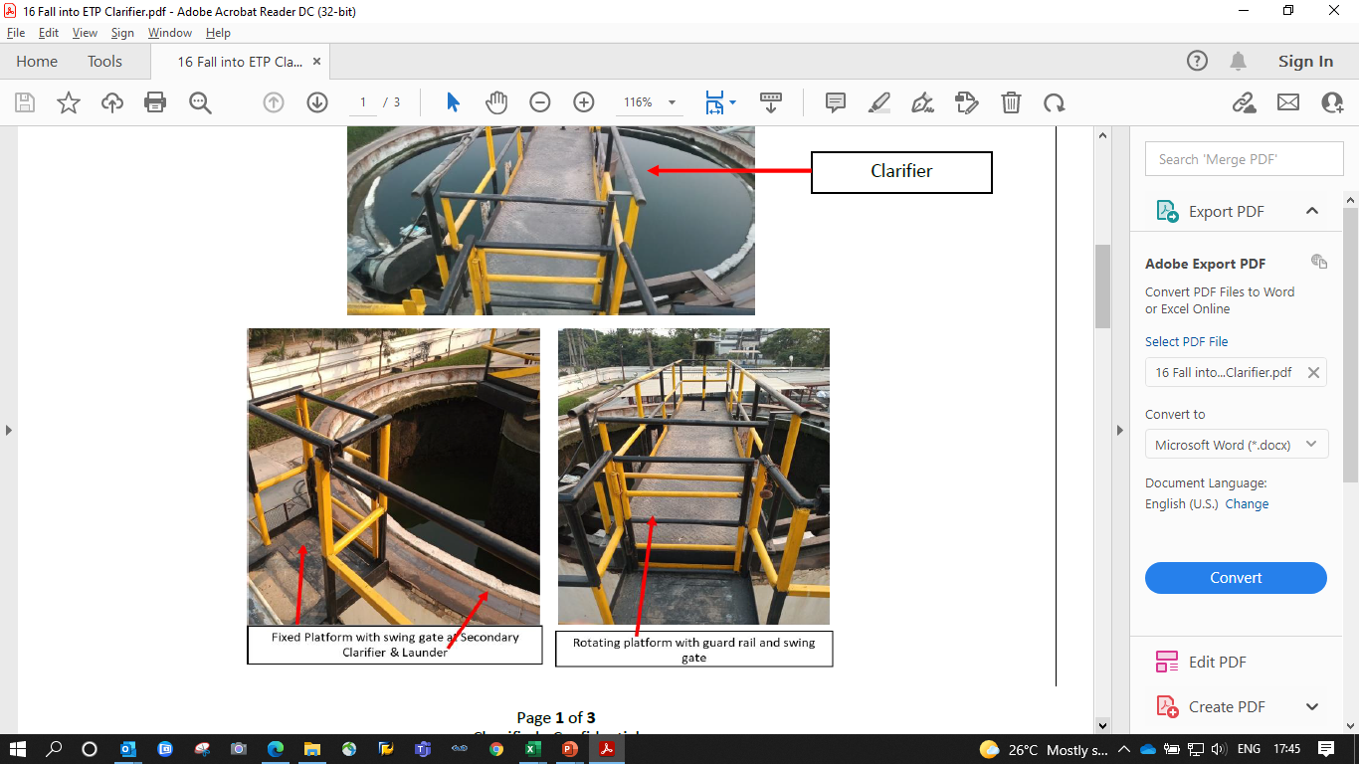
SAFETY ALERT-CALL TO ACTION ( CTA) : Fall in to Clarifier of Waste Water Plant
INCIDENT INFORMATION An operator of Wastewater Treatment plant or Effluent Treatment Plant (ETP) accidentally fell into a clarifier tank and drowned
Background
This clarifier has a moving platform with standard protection railing and gate control for any cleaning & maintenance operation on the clarifier. Operator required to step over the rotating platform for cleaning the launder area as the platform takes a rotation. This is a routine activity for which operator require to opens the gates of fixed platform and rotating platform when aligned. Operator did not wait for the alignment of rotating platform with the fixed platform instead stepped over the launder by opening the gate of the fixed platform. While walking on the launder, operator slipped, fell into the clarifier and drowned.
CALL TO ACTION
1. Risk assessment & Standard Operating Procedure (SOP) shall be made for all routine operations, cleaning, and maintenance where an associate has to walk over or around the open tanks. In ETP, it could be clarifier,
equalization tanks or any other open to air tanks inside the plant premises.
2. The SOP for routine operations must be made available at the point of use and the associates trained for such cleaning activities (launder / drains etc) on safe operations. Ensure that employees and other affected personnel are adequately trained to perform their roles and responsibilities. Implement site / job specific hazard (conditions, operations etc.) training through a standardized training deck/module to ensure right & adequate messaging on safe working.
3. Implement additional fall prevention controls such as platforms, toe guards, railings, swing gate, access control etc. throughout the circumference of the clarifiers / other open tanks to facilitate safe cleaning activities (Refer the photograph below). This is required for both fixed platform type clarifiers and rotating platform clarifiers. Example: Platform around the circumference of the clarifier for safe operations
4. Evaluate the need for any additional engineering (eg: safety interlocks, automation etc.) / operational controls to mitigate all potential risks of fall hazards. Eg: Interlock controls or other safety controls that would only allow the employee to lift the gate and access the platform ONLY when lined up with the fixed platform and de-energized.
5. Review all the CCTV footage routinely of the critical areas / high risk jobs to potentially identify unsafe acts / behaviors by the associates. Counsel the associates to perform work safely when a deviation is observed. Provide CCTV Cameras at all high-risk areas of the plant. (e.g. ETP, Loading & Unloading, Utility, Roof etc).
6. Ensure maintenance activities by the workmen on the open tanks shall start only after authorizing the work permits. Provide adequate numbers of life support vests to prevent drowning by accident. Ensure display of instructions (written / visual) at site prominently for reinforcement.
7. Standard SOP must be available and relevant employees trained on safe maintenance operations for both routine (lubrication, inspection etc) and major maintenance (drive shafts bearing change, motor repair etc). The SOP must capture the safety protocol that needs to be followed when the drive shaft gets stuck or malfunctions and the moving platform is not in alignment with the fixed platform. Establish documented preventive maintenance plan for all the equipment’s at ETP area. All maintenance of the open tanks are conducted under supervision.
8. Provide Life Jackets to associates engaged in work at ETP area including adequate fall protection controls (e.g. safety harness, horizontal lifeline with fall arrestor for tying the safety harness) as identified through risk assessment to prevent incidents of accidental drowning.
9. Identify areas (e.g. ETP, WTP) in the plant where corrosive chemicals (Acids, Caustic etc.) are being used and ensure fall protection measures (Staircase, Ladders, Platform, Railings, Swing Gates, Toe Guards, etc.) are fabricated by using compatible materials.
10. At-least on a monthly basis visual inspection of fall protections system (Staircase, Ladders, Platform, Railings, Swing Gates, Toe Guards, etc.) and on annual basis stability test is carried out by a competent person. Any Structural damaged or decay in the fall protection system, platforms etc. due to any reason following action need to be taken immediately:
• Access to damaged or decayed area shall be restricted. • Repair/replacement of damaged infrastructure and same to be used once approved by a qualified person after inspection.
11. Continue to build behavioral based safety culture in plants to mitigate unsafe acts. Establish a system of Reward & Recognition to drive positive culture.
12. Implement measurement of effectiveness of above controls through Senior Leadership routines to review progress on all action plans related to strengthening safety controls at least on monthly basis.
13. Stop any kind of operations at clarifier/open tanks till adequate controls are not in place.
Note: The risk assessment and controls are site specific and the operations must implement action plan suited for their specific infrastructure, process and prevailing safety culture.

Slide 9
SAFETY ALERT-Never Again :Truck hit with forklift
Sr.No. | Recommendation
1 | All personnel working in traffic movement area shall wear bright and visible clothing (reflective vest)
2 | Awareness information and/or instruction must be provided on a regular basis to the driver which includes the reinforcement of key safety issues such as critical aspects of safe operation (Parking, Turning, Reversing etc.)
3 | Before getting down from vehicle, driver to switch off engine, engage right gear and remove ignition key.
4 | Consequence matrix is well communicated to transporters & actions taken for safety violations.
5 | Digitalization of vehicle movement to limit entry of vehicle inside premises.
6 | Ensure communication to transporter for not to violate any Safety related legal obligation & HCCB safety guidelines.
7 | Ensure display of traffic marshal role & responsibility in local language, speed limit board, road safety warning signs.
8 | Ensure installation of proper traffic furniture such as road signs,markings,traffic control devices / barriers,traffic lights, speed breakers ,mirrors,etc.for smooth movement of traffic & minimize the accidents.
9 | Ensure provision and wearing of reflective jacket by all drivers.
10 | Ensure provision of adequate trained, dedicated trained traffic Marshall with dress code for vehicle movement control.
11 | Ensure provision of reverse horn along with presence of trained traffic Marshal while reversing the vehicle.
12 | Ensure wearing of safety helmet , full body harness , safety shoes by the drivers while doing tarpaulin tying activity.
13 | Only drivers to be allowed with the vehicle. No helper to be allowed inside plant. Ensure availability of trained casual for tarpaulin tying activity.
14 | Proper assessment of vehicle parking place and how many vehicles can be parked at a time has been done and parking place is properly marked with yellow line.
15 | Proper review of traffic route and ensure adequate man machine segregation.
16 | Provision and Use of batten light and red/green flag by traffic Marshall must be ensure.
17 | Provision of adequate visible embankments on road edge to avoid toppling of vehicle during turning.
18 | Review of risk assessment of vehicle movement in premises (considering the potential road/traffic hazards, black spots, possible weak areas, slopes, adequacy of road width, gate width, turning radius).
19 | Sitting, drinking water, toilet arrangement for Drivers and helpers near gate within control of security.
20 | Wheel chokes to be always applied when vehicle is parked.

